Slide 1
More OOP! Encapsulation and Examples
Week 11 | Lecture 1 (11.1)

Slide 2
This Week’s Content
Lecture 11.1
More OOP! Encapsulation and Examples
Lecture 11.2
Advanced Data Structures: Linked Lists
Lecture 11.3
Design Problem! Gaussian Elimination

Slide 3

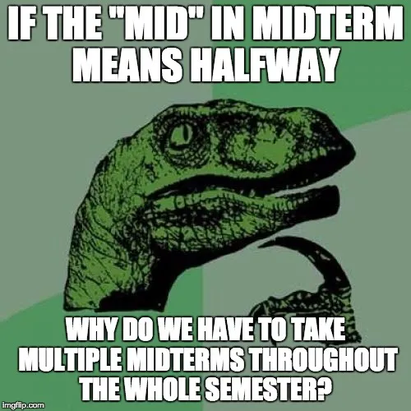

But First! The Midterm…

Slide 4

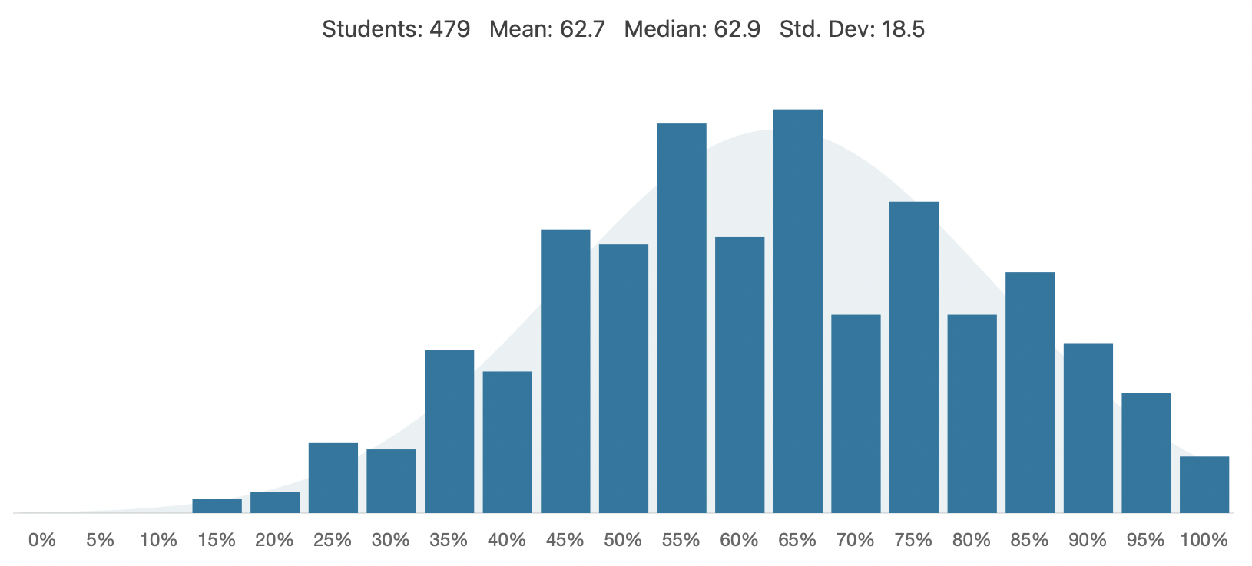
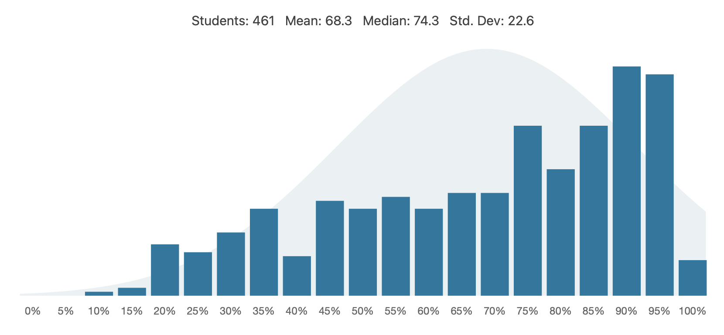
Midterm 1 vs. Midterm 2

Slide 5
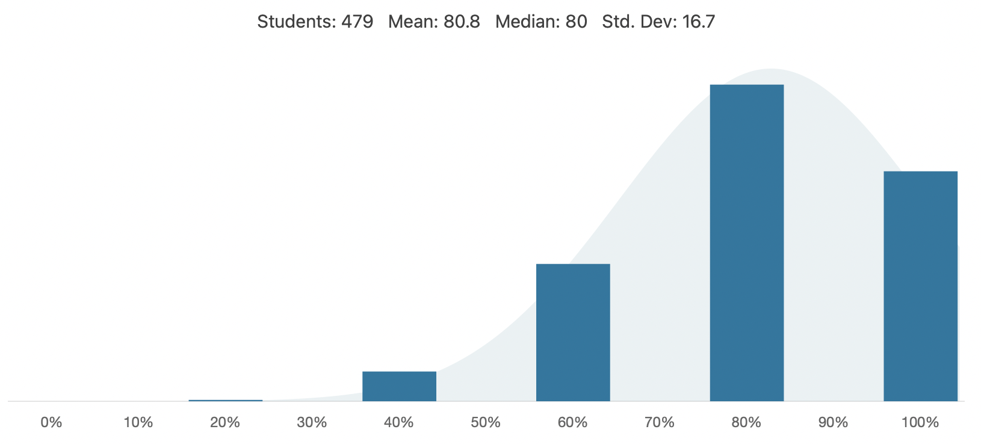
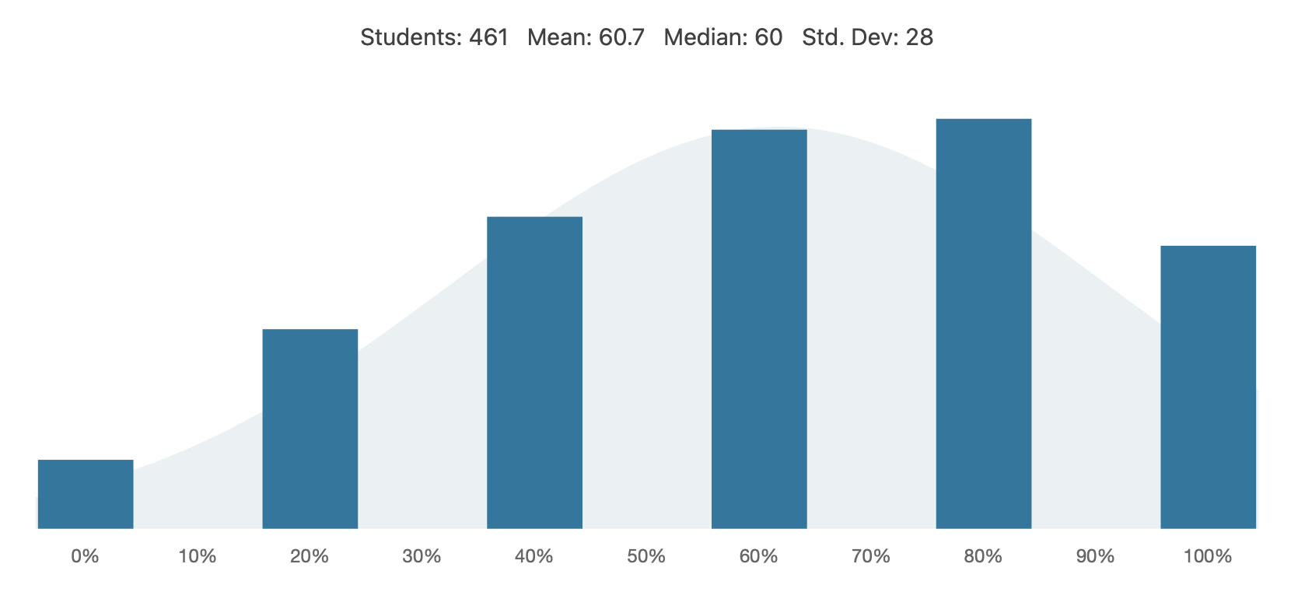
Question 1

Slide 6
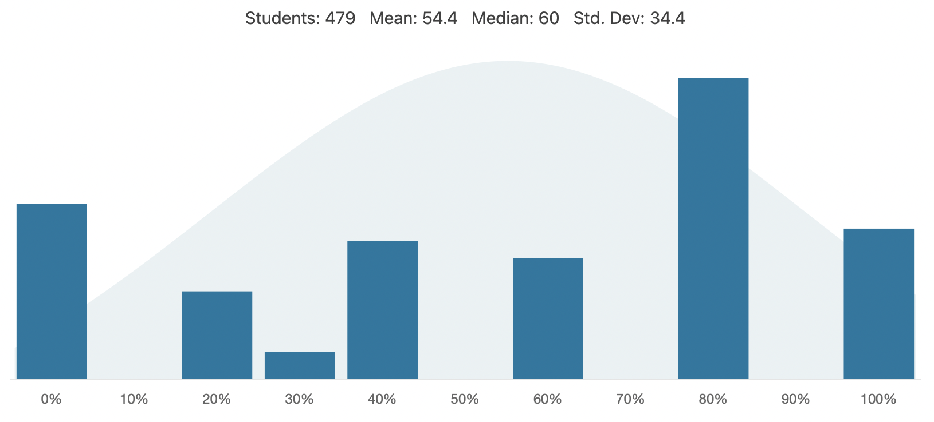
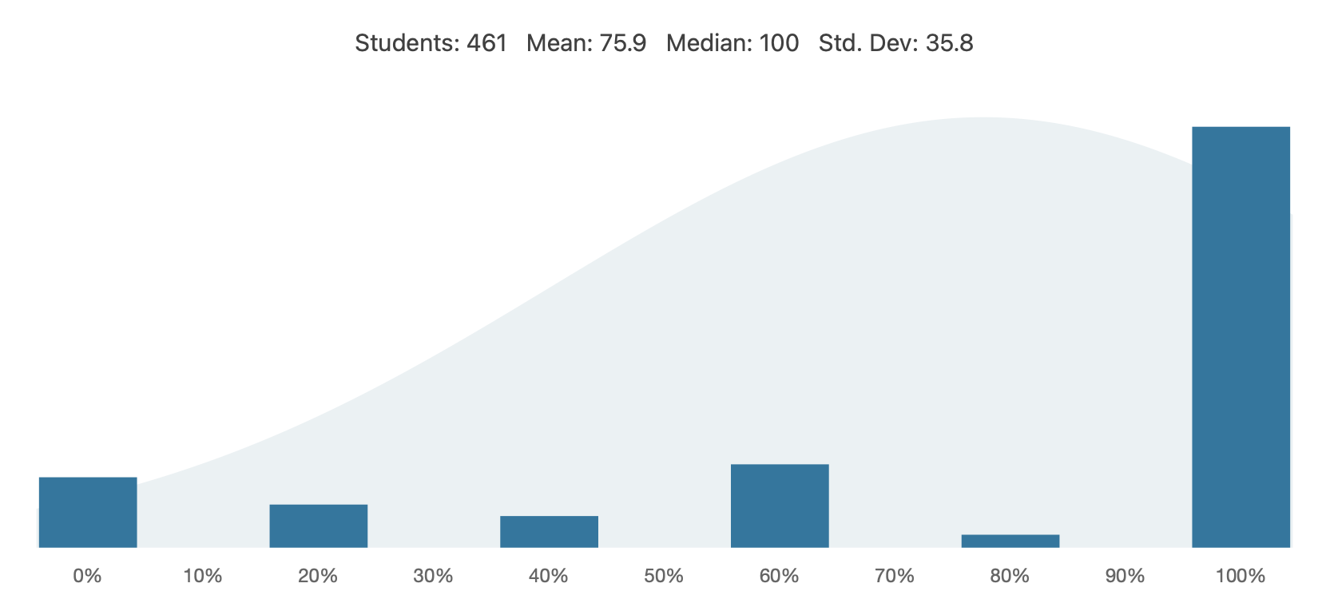
Question 2

Slide 7
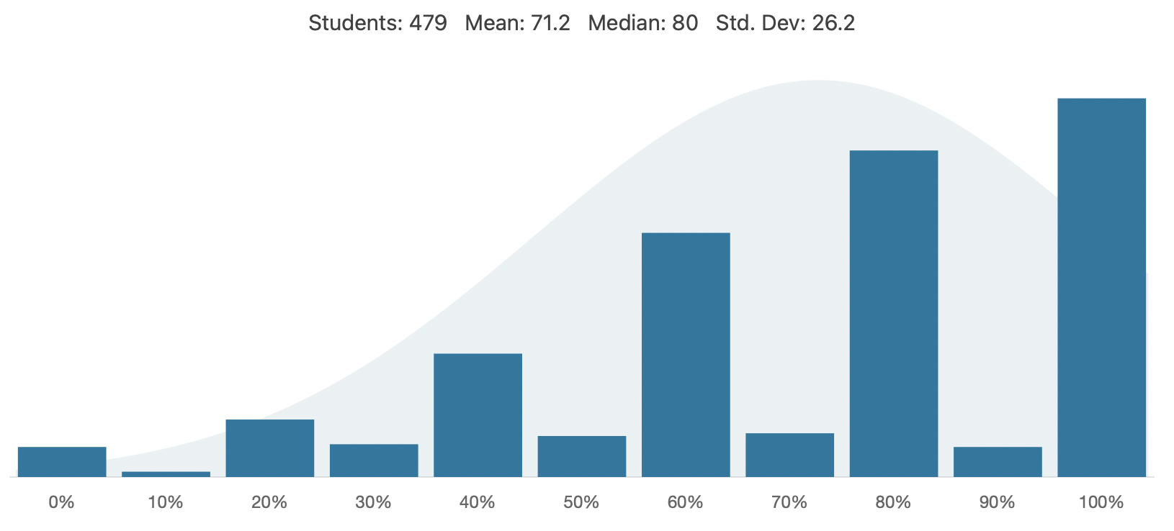
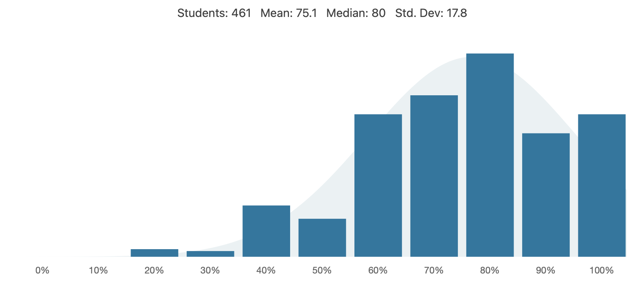
Question 3

Slide 8
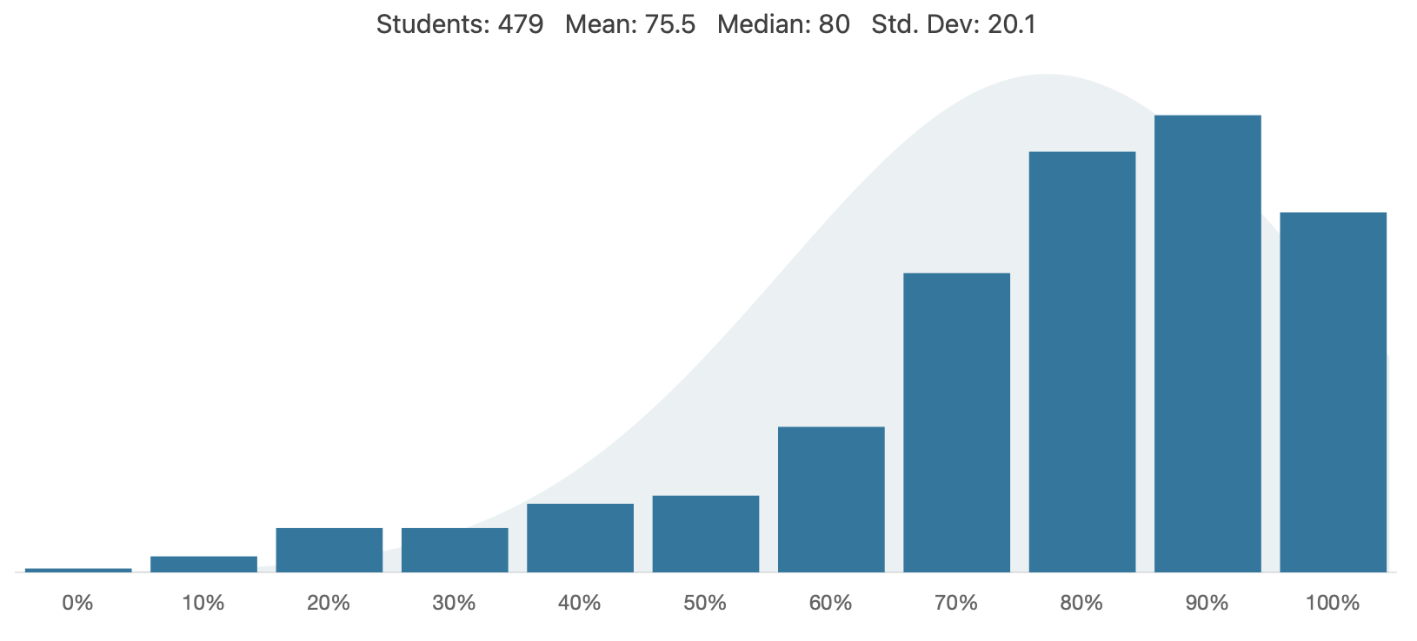
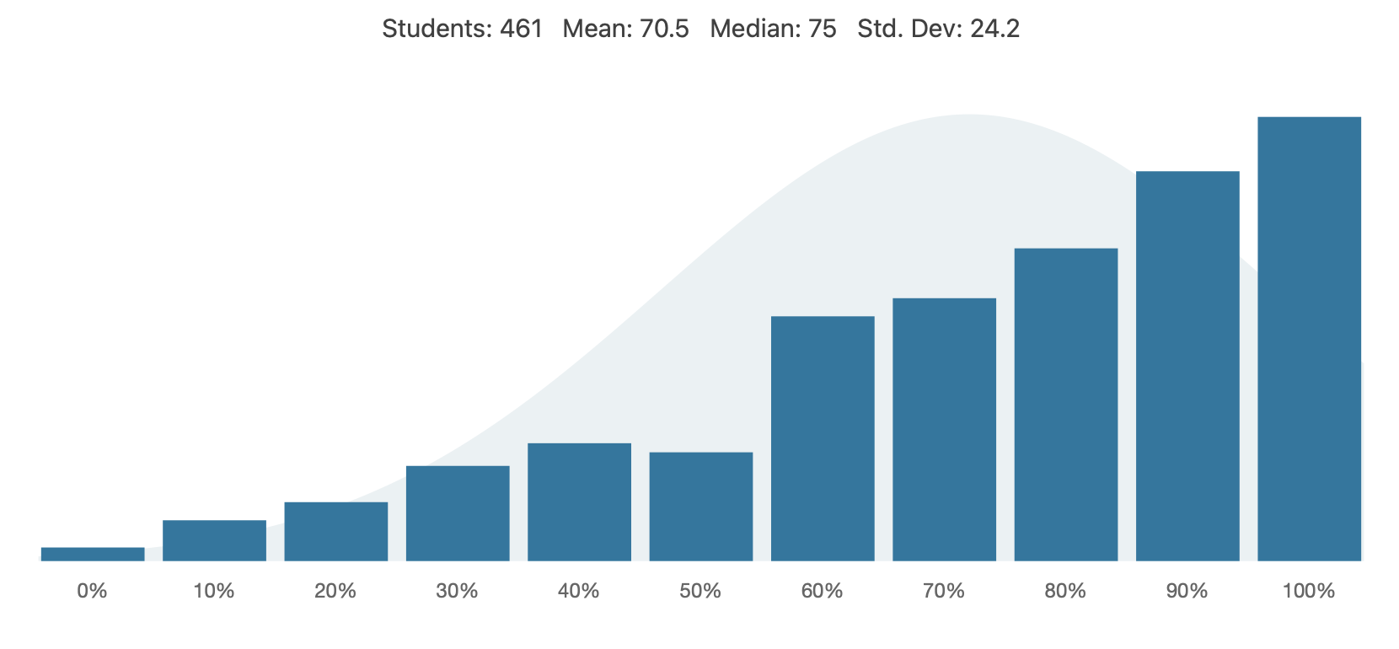
Question 4

Slide 9
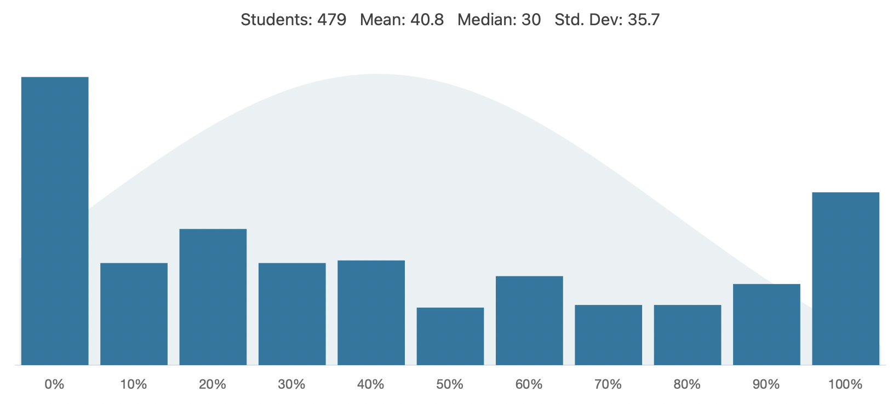
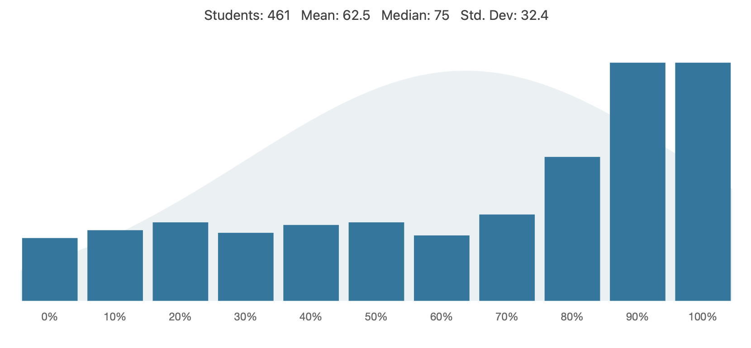
Question 5

Slide 10



Exam: April 23, 9:30 AM Clara Benson Building (BN)

Slide 11

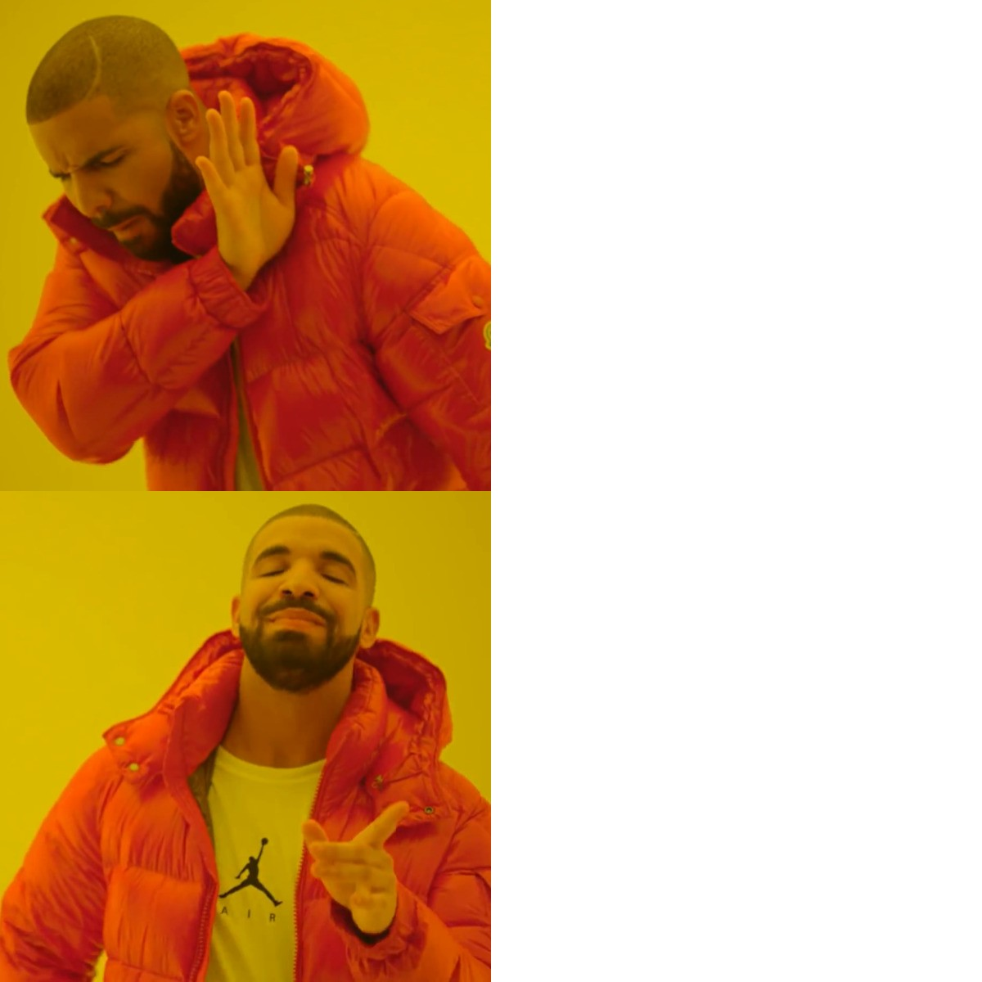
Coffee Break with a TA!
Extra help hours!
TIP FOR SUCCESS: Put in calendar, treat as a scheduled class
Schedule and Link is on Quercus
Bottom of APS106 course site
Link is same as Tutorial Zoom Room
Office Hours
TA name | Time
Navid Kayhani | Tuesdays 4 PM to 7 PM
Minori Narita | Wednesdays 5 PM to 6 PM Fridays 3 PM to 5 PM
Ali Howidi | Thursdays 10 AM to 1 PM
Shengbo Zhang | Mondays 5 PM to 6 PM Fridays 5 PM to 7 PM
Coffee Break

Slide 12
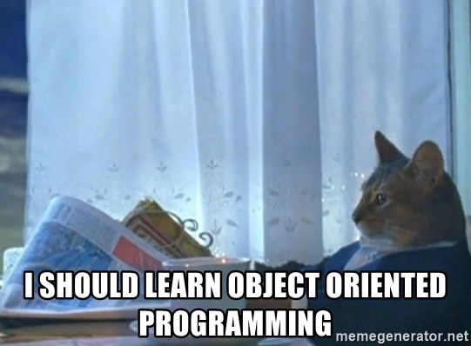
Why OOP?
Models our real-life thinking
Sandwich – ingredients, freshness, etc.
Car – model, year, fuel level, forward, reverse etc.
Movie – actors, director, genre, rating, etc.
Cat – weight, name, colour, scratch, meow, sleep, etc.
Why do we use it in programming?
Default values for a new object (initialization)
Properly set-up, predictable behaviours of different objects within the same class

Slide 13
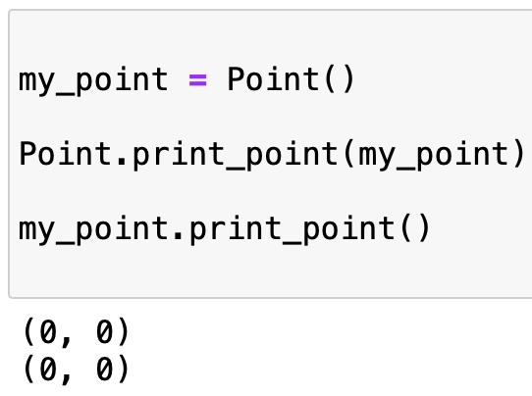
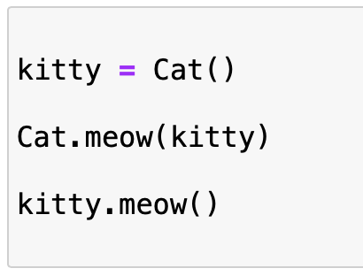

Why OOP?
The reason for this dot operator convention is an implicit metaphor:
The syntax for a function call, Cat.meow(kitty) suggests that the function is the active agent. It says something like, “Hey meow function! Here’s a Cat object (named kitty) for you to meow with.”
In OOP, the objects are the active agents. A method invocation like kitty.meow() says “Hey kitty! Please meow.”

Slide 14
Encapsulation
Encapsulation
seb.forward(50)
kitty.scratch()
The core of object-oriented programming is the organization of the program by encapsulating related data and functions together in an object.
To encapsulate something means to enclose it in some kind of container.
In programming, encapsulation means keeping data and the code that uses it in one place and hiding the details of exactly how they work together.
Class
Attributes
Methods

Slide 15
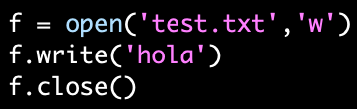
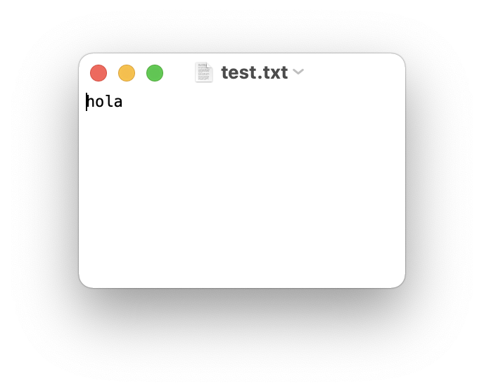
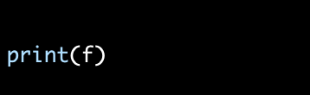
Encapsulate it!
For example, each instance of class file keeps track of which file on the disk it is reading/writing and where it currently is on that file.
The class hides the details of how it is done, so we (as programmers) can use it without needing to know how it is implemented

Slide 16
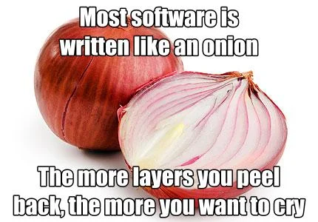
Let’s Code!
Let’s look at how this works in Python!
Point Class Recap
Rectangle Class
Open your notebook
Click Link:
1. Encapsulation

Slide 17
Printing Information
It would be nice to not have to write a print statement when we want to display attribute information:
Is there a better way to encapsulate this? How about a method?
>>> p = Point(3,4)
>>> print(p)
<__main__.Point object at 0x7fd8100778b0>
>>> p = Point(3,4)
>>> print(p.x, p.y)
3 4
>>> p = Point(3,4)
>>> p.to_string()
'(3,4)'
>>> r = p.halfway(Point(5,12))
>>> r.to_string()
'(4,8)'

Slide 18
Printing Information
If we had a method, we just need to format the attributes into a string:
We could make a similar method for any class (ex: Square)
class Point:
"""A class that represents and manipulates 2D points"""
def to_string(self):
"""
(self) -> None
Prints the (x, y) coordinate for the point.
"""
print('(' + str(self.x) + ', ' + str(self.y) + ')')
>>> p = Point(3,4)
>>> p.to_string()
'(3,4)'
>>> r = p.halfway(Point(5,12))
>>> r.to_string()
'(4,8)'

Slide 19
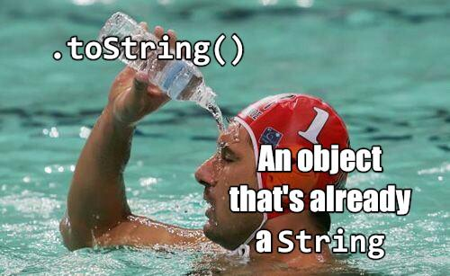
Printing Information
If every class we made had a to_string() method, great!
Easy to remember
All formatting specific to printing an object would be encapsulated
But they won’t all have one…
What if other people made their own method for printing and called it something else?
Then it would no longer be obvious how to quickly display information
Is it called to_string? tostring? 2stringz? print_point? plz_print_me?
Python has a clever trick for this!

Slide 20
Printing Information
If we call our new method __str__ instead of to_string, Python will use our code whenever it needs to convert Point to a string
class Point:
"""A class that represents and manipulates 2D points"""
def __init__(self, x=0 , y=0):
...
def __str__(self):
return (‘(’ + str(self.x) + ‘,’ + str(self.y) + ‘)’)
>>> p = Point(3,4)
>>> print(p)
'(3,4)'
That’s better!
When we call print(obj), then obj.__str__() is called to find out what string to print

Slide 21
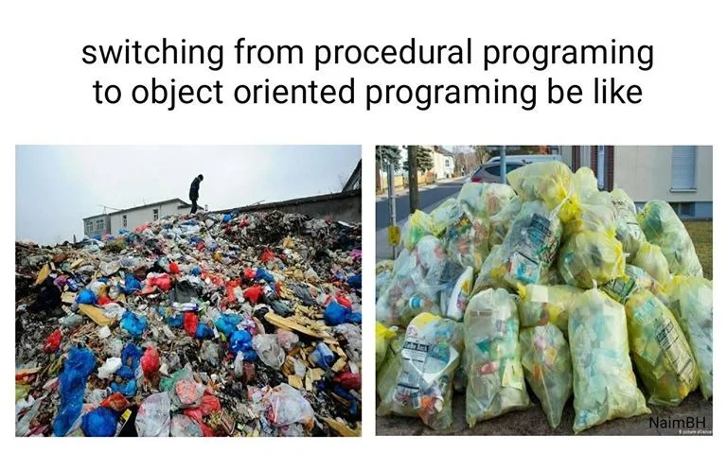
Let’s Code!
Let’s look at how this works in Python!
__str__ method
Open your notebook
Click Link:
2. Printing Objects

Slide 22


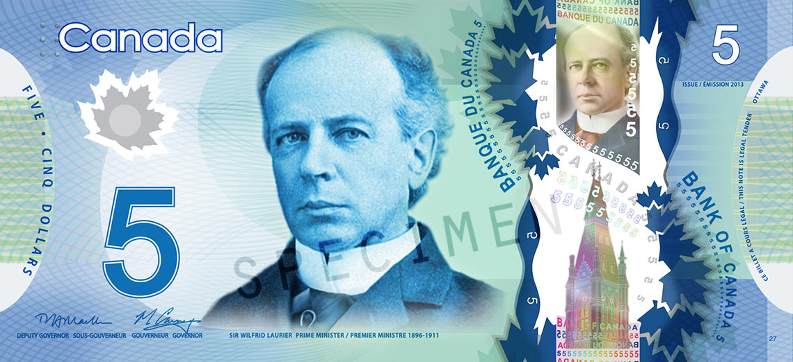
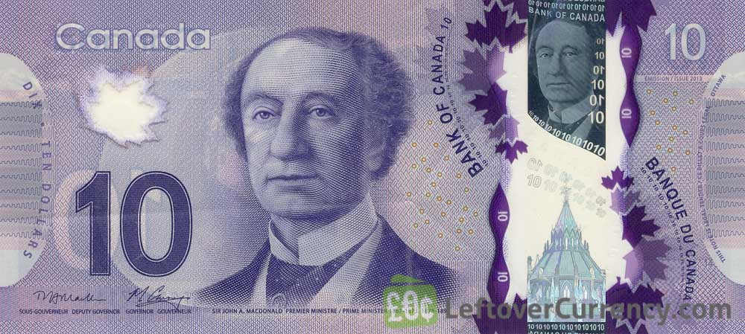
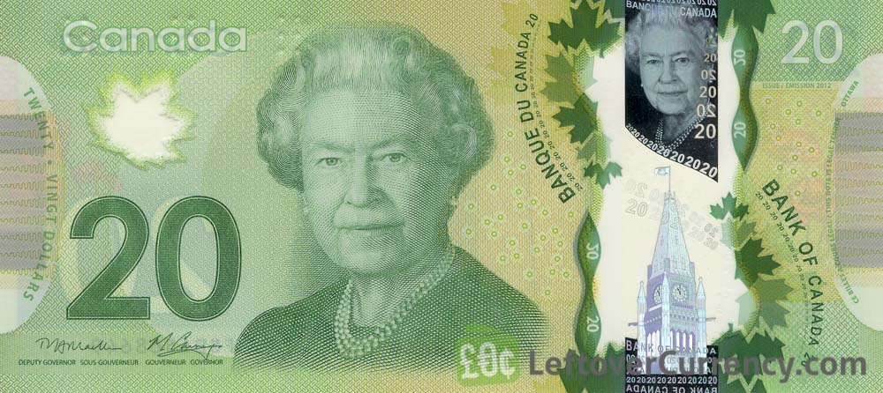
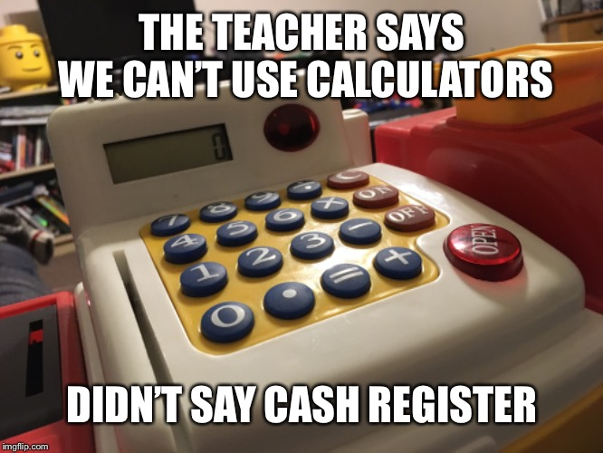
Let’s Build a Cash Register!
We want to build a cash register program. What features do we want?
Track number of:
Loonies
Toonies
$5 bills
$10 bills
$20 bills
Accepts cash
Removes cash
Calculates value of contents
Print the entire contents

Slide 23
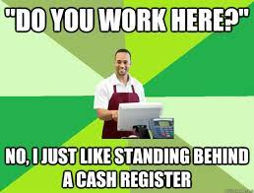
Breakout Session!
Let’s look at how this works in Python!
Building a cash register
Attributes
Methods
Including __str__ method
Open your notebook
Click Link:
3. Building a Cash Register

Slide 24
More OOP! Encapsulation and Examples
Week 11 | Lecture 1 (11.1)

